Slide 1
US electricity data cube design
--project for “data management and application” course
Team members：
Hongjin Zi
Yuanpeng Wang

Slide 2
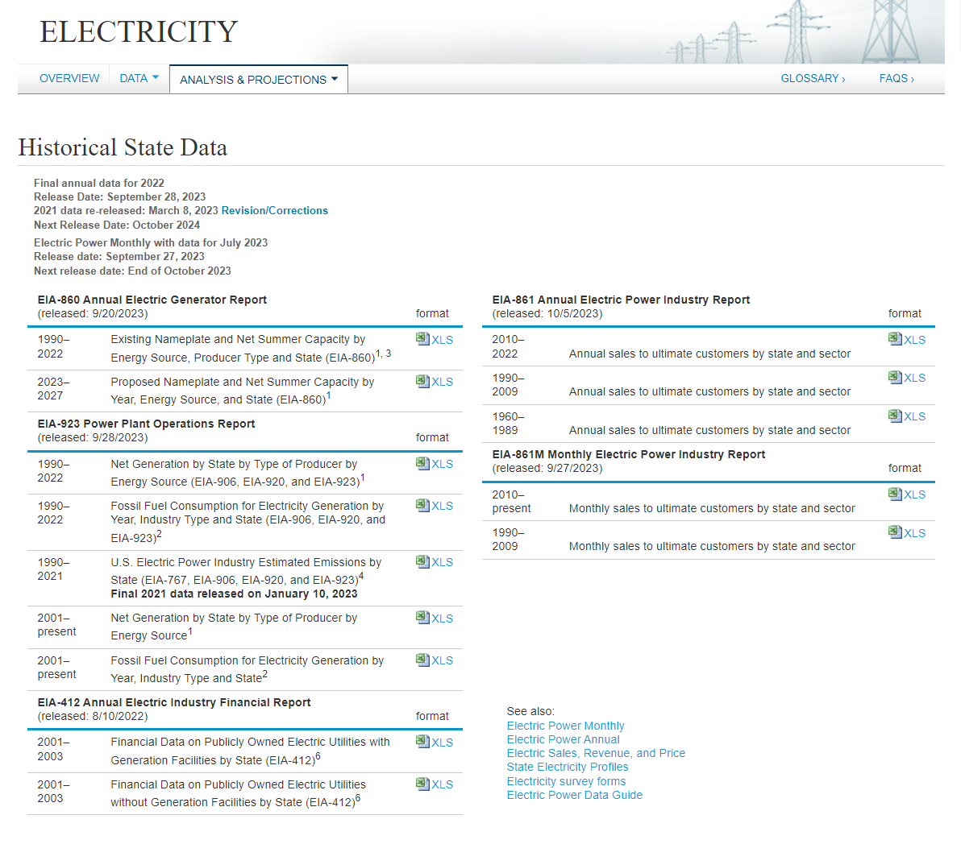

Dataset selection – Source from EIA to build US Electricity information data cube in this project
Detail electricity capacity included in Excel by energy source
The electricity dataset selected for this project was from US Energy Information Administration
The data in those 5 excels are massive，tailored data are used for this project
Those dataset used in this project is to design a datacube to help authorities analysis，manage and regulate the electricity industry efficiently
Consumer usage information included
Electricity production and fossil fuel consumption included
Source ：https://www.eia.gov/electricity/data/state/

Slide 3
US electricity data cube design :Dimensions
for electricity usage part:
Dimensions: Area, Time, User type are chose
Measures：electricity usage, revenue, unit price
for electricity production part:
Dimensions: Area, Time, Energy source are chose
Measures：electricity production amount
Hierarchical summarization paths
User
Area
Time
Source
ALL
ALL
ALL
ALL
Region
Year
Energy category
User Type
Energy Source
State
Quarter
electricity usage
electricity production
Month

Slide 4
US electricity data cube design : Concept hierarchies
AREA
All
ALL
Region
West
Middle
West
South
West
South
East
North
East
State
WA
…
CA
AZ
…
TX
NY
…
ME

Slide 5
US electricity data cube design : Concept hierarchies
TIME
All
All
ALL
USER
ALL
Year
Year1
Year2
Year N
User Type
Residential
Industrial
Commercial
Transportation
Quarter
Q1
Q2
Q3
Q4
Month
1
2
3
…
10
11
12

Slide 6
US electricity data cube design : Concept hierarchies
SOURCE
ALL
All
Other
Energy
category
Fossil
NGreen
Coal
Geothermal
Petroleum
Traditional
Solar Thermal and Photovoltaic
Energy
Source
Natural Gas
Other Biomass
Hydroelectric Conventional
Wind
Nuclear
Other Gases
Pumped Storage
Wood and Wood Derived Fuels

Slide 7
US electricity data cube design the model :Fact constellation and rationale
Fact constellation:
PRODUCTION
TIME
USAGE
Time ID
Area ID
Source ID
Production amount
Time ID
Year
Quarter
Month
Time ID
Area ID
User ID
Usage
Unit price
Revenue
SOURCE
Source ID
source category
Energy type
USER
User ID
User Type
AREA
Area ID
Region
State
Regulatory Name
Rationales:
target is to build data cube to support analysis the whole us electricity market from production and usage perspective, like market volume, user behaviors, usage trend prediction, region gap, energy source, green source utilization percentage, … to support plant planning ,expansion, regulating, policy making…
dimension tables are build as Area(region, state),Time(year, quarter, month )user type(residential, industrial, commercial, transport),energy source(category,13 sources)
Usage fact table include 3 measures: usage, unit price, revenue
Production fact table include 1 measure: production amount
We have 2 fact tables and both share Time and Area dimension table, so fact constellation are used for modelling

Slide 8
primary key design in dimension table for easier analysis the fact table
key time_ID is combination of year, Quarter, month
20100101 = 2010(year)+ 01(1st quarter) + 01(Jan)
time_id | _year | _quarter | _month
2010101 | 2010 | 1 | 1
2010102 | 2010 | 1 | 2
2011101 | 2011 | 1 | 1
2011102 | 2011 | 1 | 2
2012101 | 2012 | 1 | 1
2012102 | 2012 | 1 | 2
2013101 | 2013 | 1 | 1
PRODUCTION fact table
time_id | area_id | source_id | produced_amount _megawatts
2010101 | 201 | 101 | 3846057
2010101 | 201 | 102 | 22538
2010101 | 201 | 103 | 77863
2010101 | 201 | 202 | 448384
2010101 | 201 | 201 | 68444
2010101 | 201 | 302 | 737823
2010101 | 201 | 304 | 10137
key source_ID is combination of category and type
102 = 1(category: fossil)+ 02(2nd type Petroleum)
source_ id | source_ category | source_type
101 | fossil | Coal
102 | fossil | Petroleum
103 | fossil | Natural Gas
201 | traditional | Hydroelectric Conventional
202 | traditional | Nuclear
203 | traditional | Pumped Storage
204 | traditional | Wood and Wood Derived Fuels
205 | traditional | Other Gases
301 | green | Solar Thermal and Photovoltaic
302 | green | Wind
303 | green | Geothermal
304 | green | Other Biomass
305 | green | Other
key area_ID is combination of region, state
201 = 2(region: Midwest)+ 01(1st state in this region IA)
area_id | in_region | in_state
101 | Northeast | CT
102 | Northeast | DE
103 | Northeast | MA
104 | Northeast | MD
105 | Northeast | ME
106 | Northeast | NH
107 | Northeast | NJ
108 | Northeast | NY
109 | Northeast | PA
110 | Northeast | RI
111 | Northeast | VT
201 | Midwest | IA
202 | Midwest | IL
203 | Midwest | IN
204 | Midwest | KS
design the primary key in dimension table with related meaning will be easier to do group, extract, slice, dice…analysis the dataset. And also easier understand the fact table
Notes:
FuelSource ( coal petro, Gas)

Slide 9
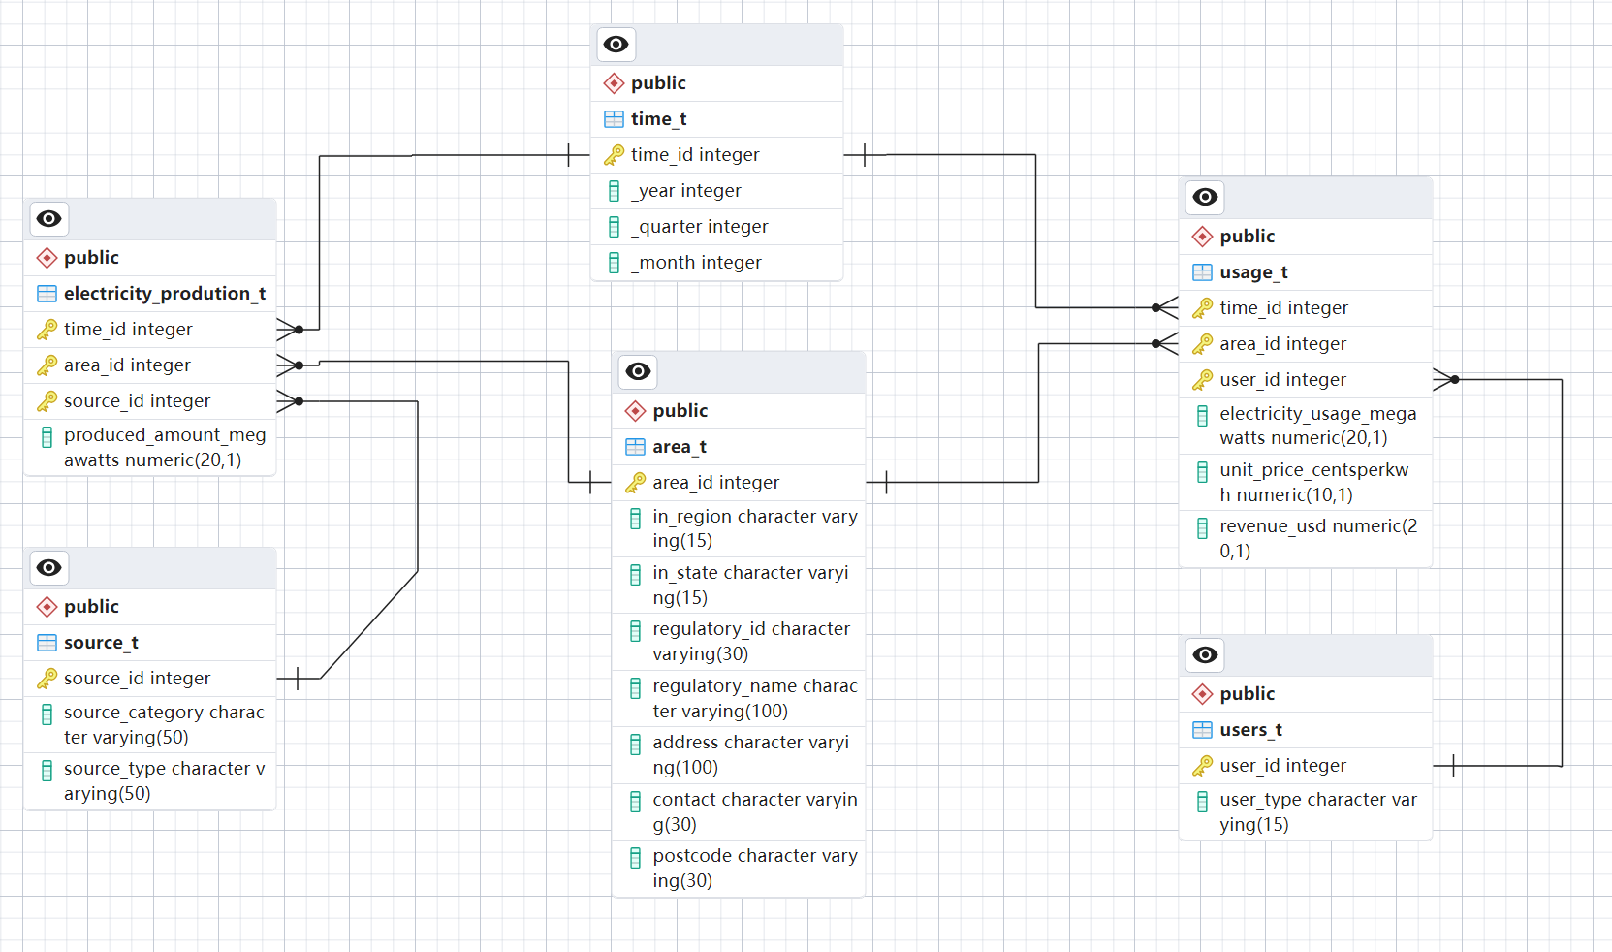
US electricity data cube Fact constellation after implementation in database
Electricity Production
fact table
Electricity Usage
fact table

Slide 10
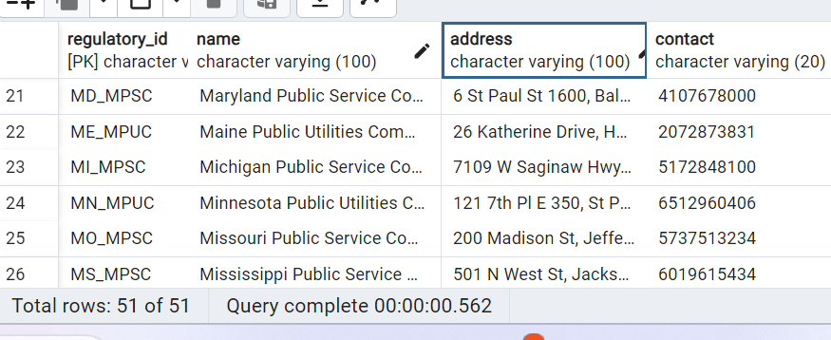
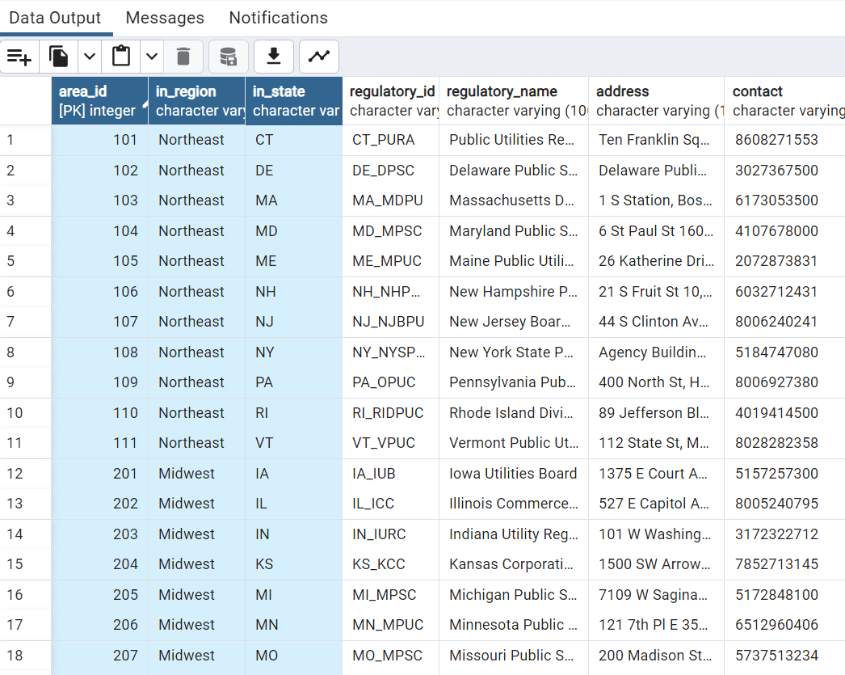
ETL: Deliverable 1 regulatory table get Area_T dimension table
Add
Area id, region, state column to get hierarchy architecture
Notes:
FuelSource ( coal petro, Gas)

Slide 11
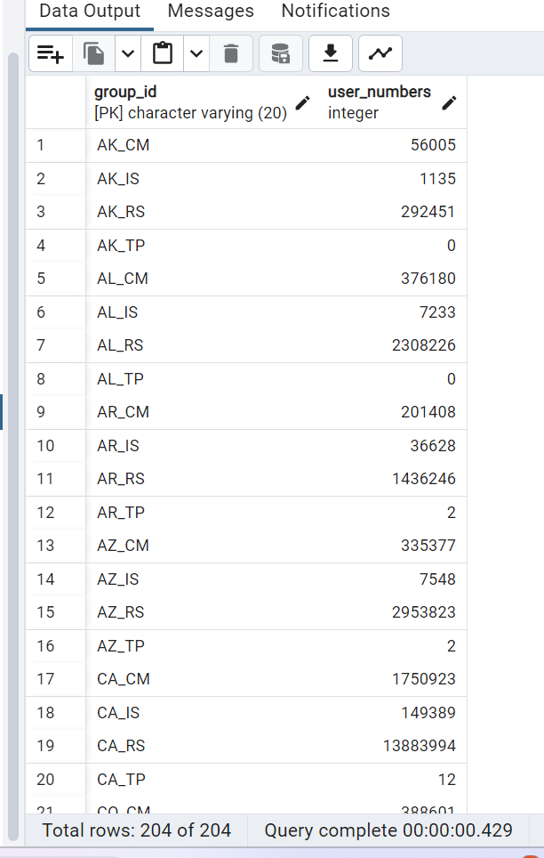
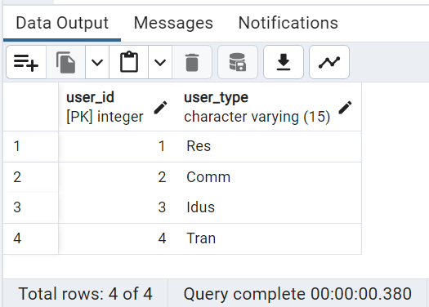
ETL: Deliverable 1 usergroups_t table get Users_T dimension table
Simply previous table
Only need user type to build the user dimension
Notes:
FuelSource ( coal petro, Gas)

Slide 12
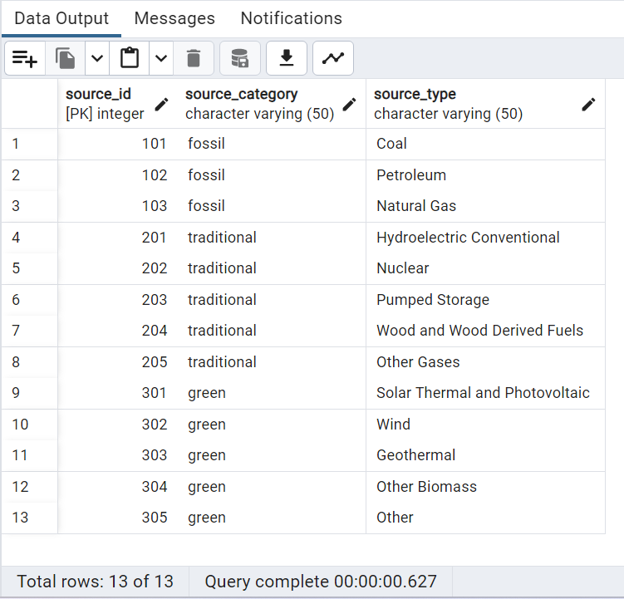
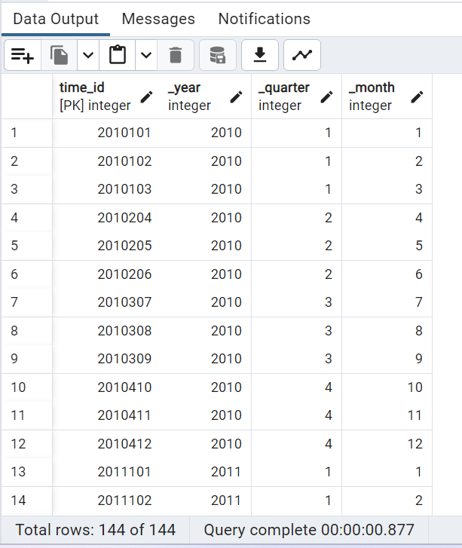
ETL: new dimension table created to support Drill down analysis
Create energy source_t table to build
Category-source type dimension
Create time_t table to build
Year-quarter-month dimension
Notes:
FuelSource ( coal petro, Gas)

Slide 13
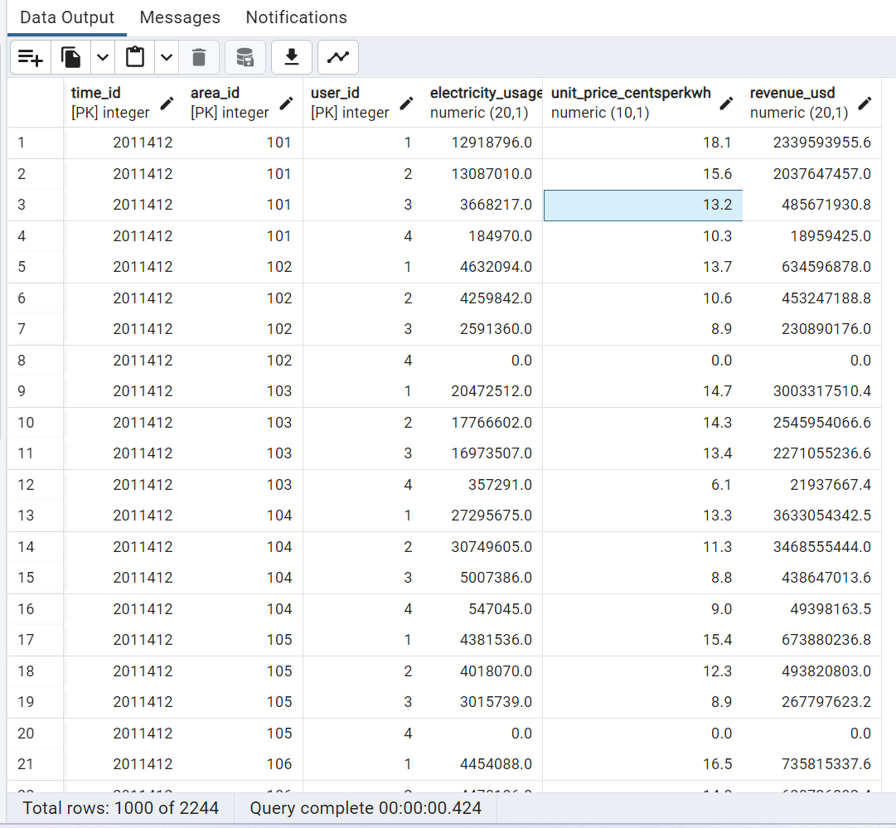
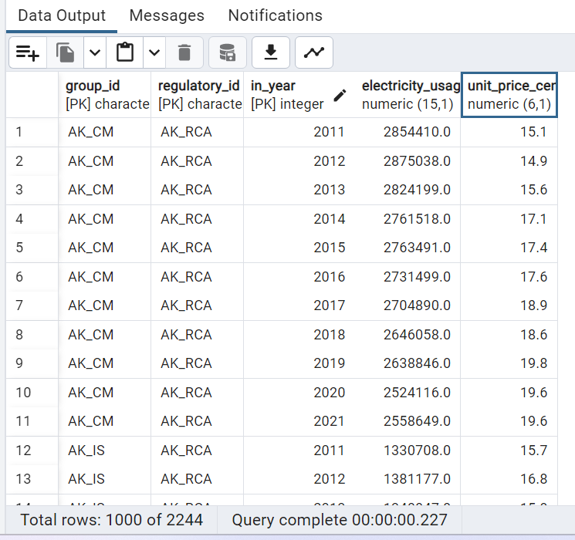
ETL: fact table usage_t modified from deliverable 1 usage_tabel
Deliverable 1 table for recording data
fact table was modified from old one by
Add revenue column as measures to analysis the dollar volume of electricity market , and also using time,area,user dimension keys for easier analysis data
Notes:
FuelSource ( coal petro, Gas)

Slide 14
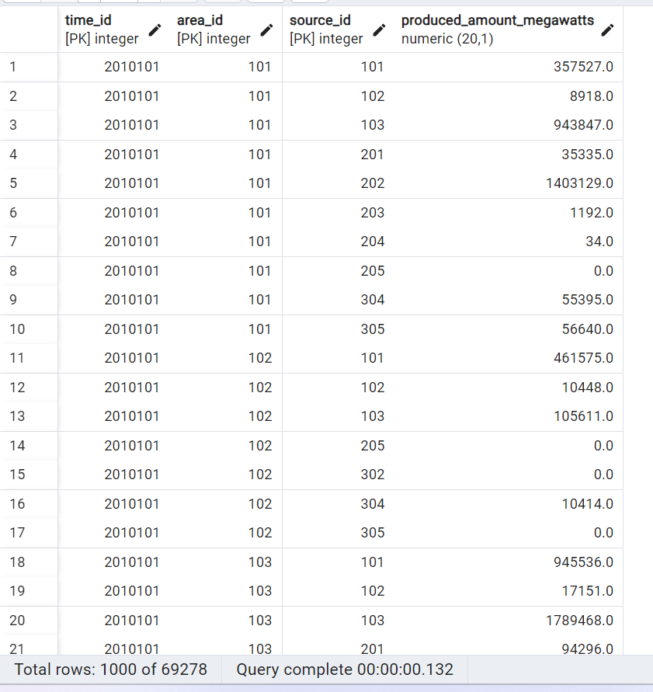
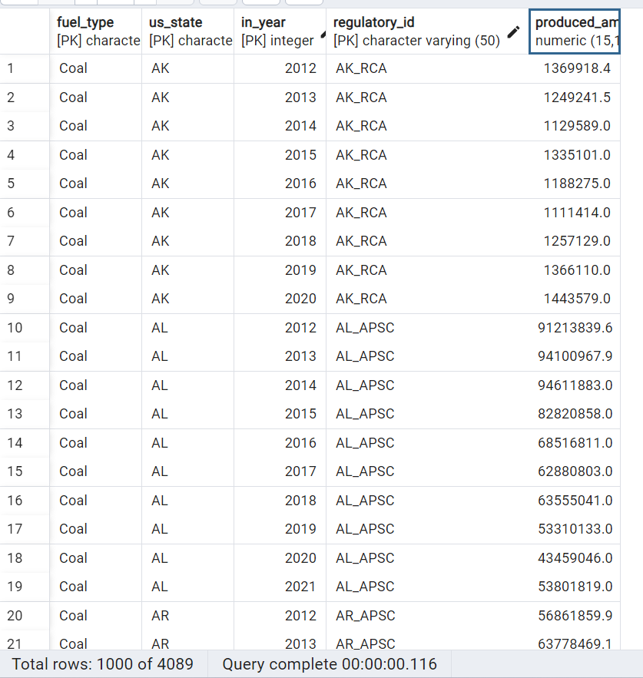
ETL: new fact table created to support Drill down analysis
Deliverable 1 production table are good for record not good for data analysis
Electricity_production fact table was built can be analysis from time,area,soure different dimension easier for analysis
Notes:
FuelSource ( coal petro, Gas)

Slide 15
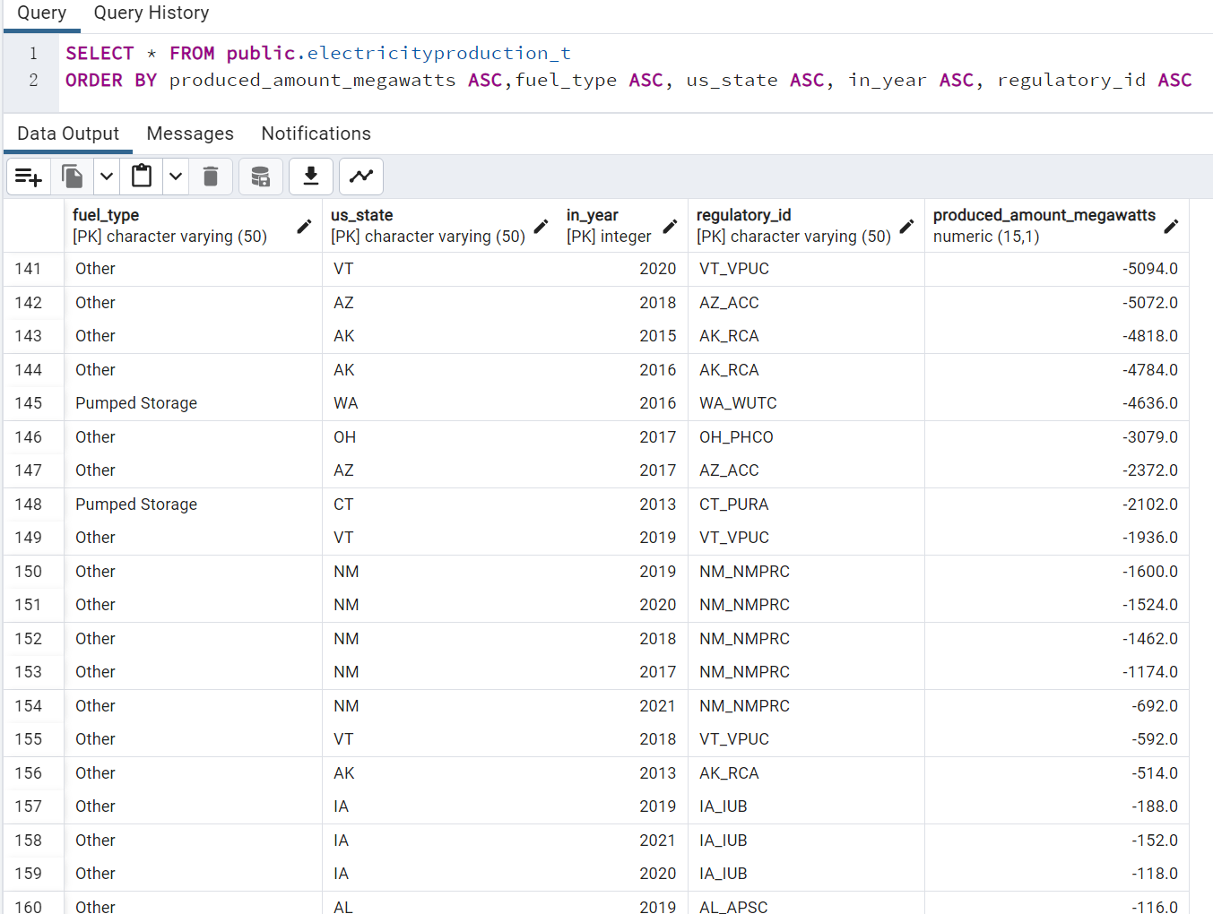
ETL: Adjust some error data
Some unreasonable negative data are set to be zero
Notes:
FuelSource ( coal petro, Gas)

Slide 16
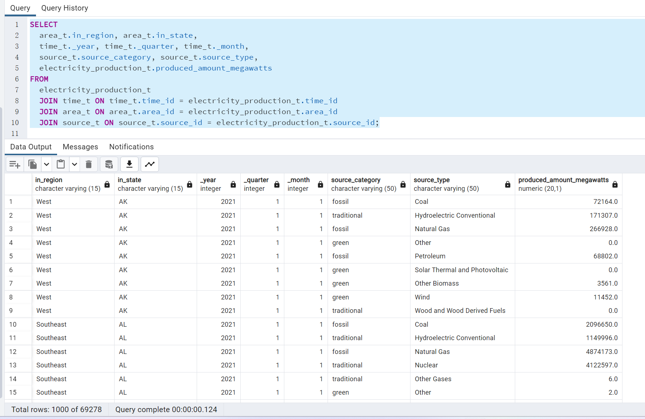
Create a full view for data mining
Include time ，area，energy type，measures：production
Notes:
FuelSource ( coal petro, Gas)

Slide 17
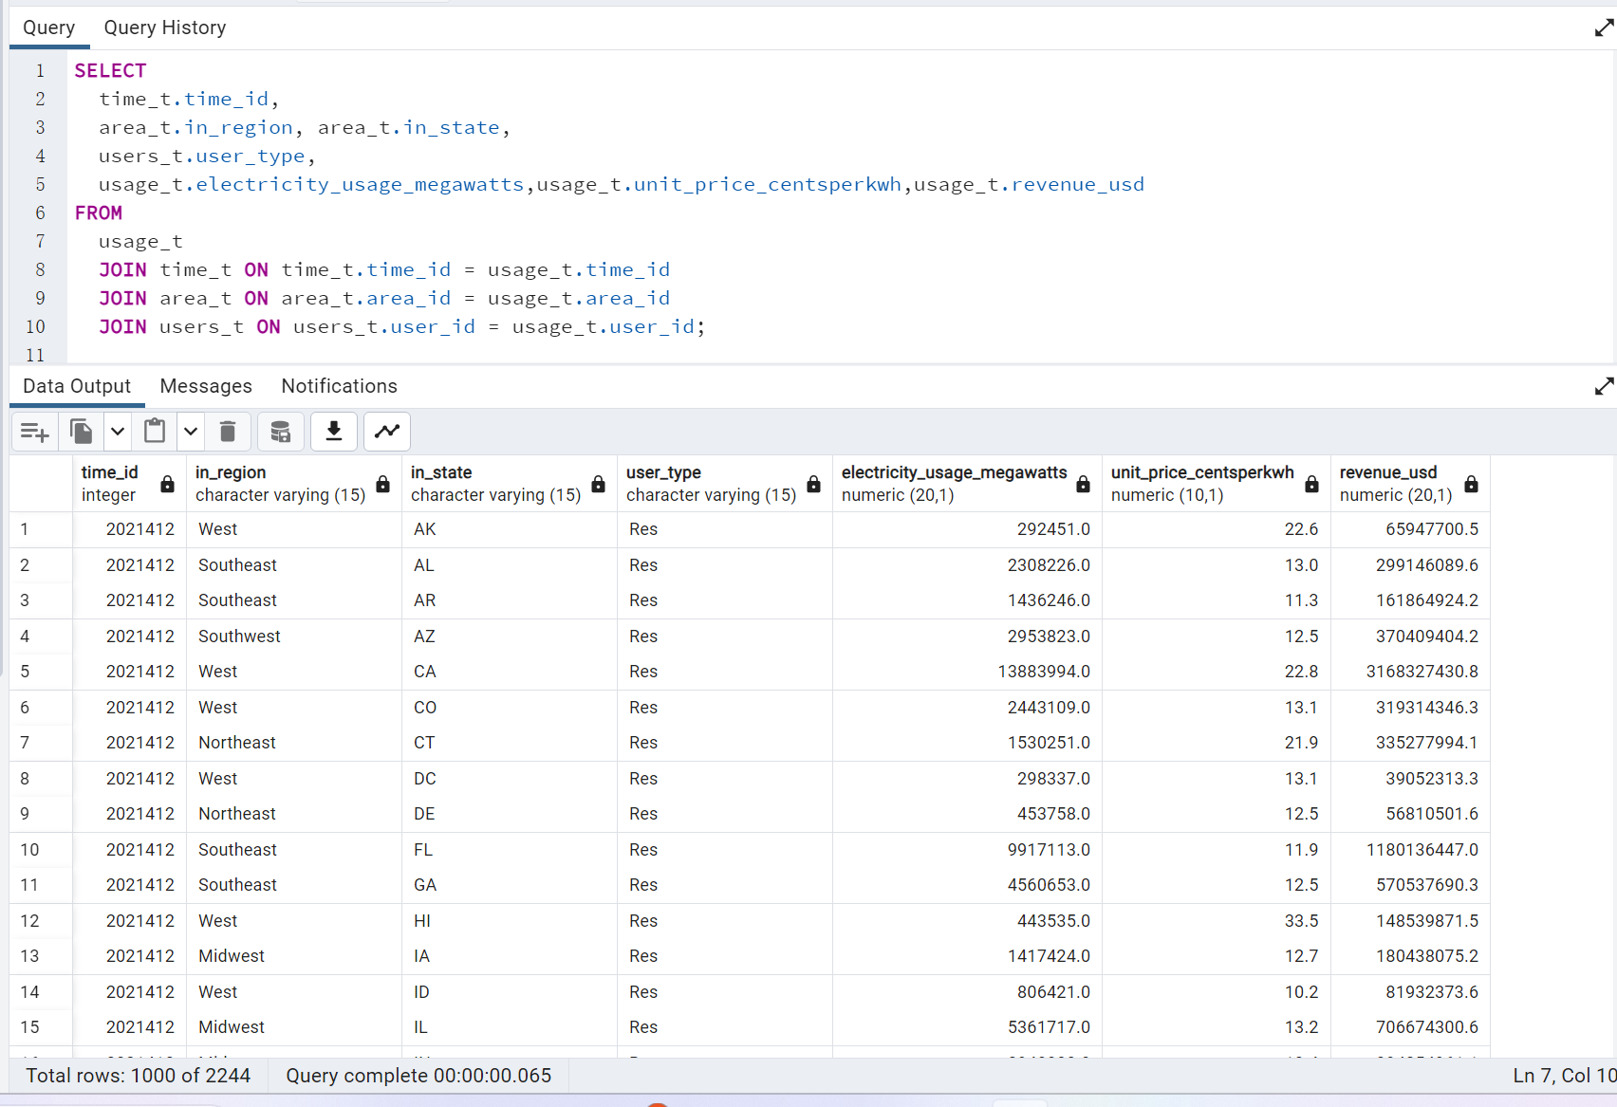
Create a full view for data mining usage
Include time ，area，energy type，measures：usage，unit price，revenue
Notes:
FuelSource ( coal petro, Gas)

Slide 18
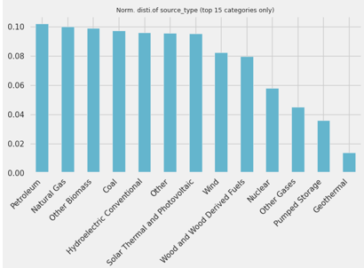
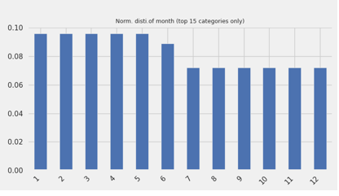
Analysis and Charts samples
Electricity Production:
Petroleum is the first source of electricity production in the normal distribution in the US.
Electricity is mainly produced from Jan. to Jun. in normal distribution in one year in the US.
Notes:
FuelSource ( coal petro, Gas)

Slide 19
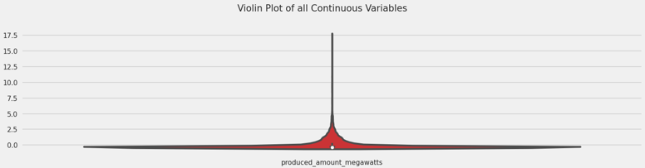
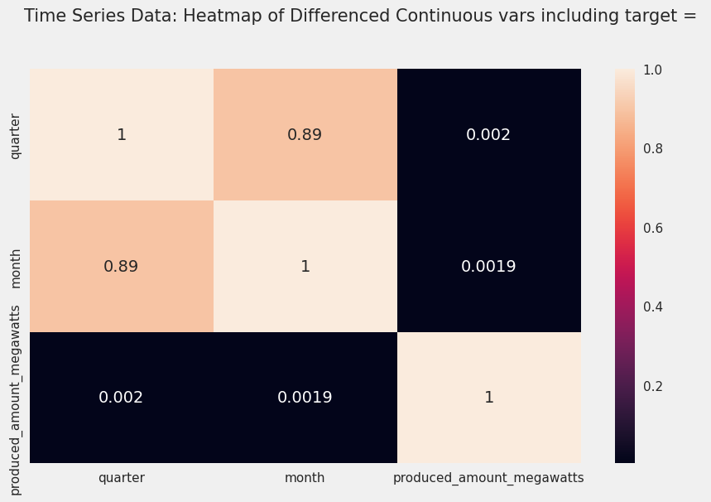
Analysis and Charts samples
Violin Plot and Heatmap of Electricity Production in the US:
Notes:
FuelSource ( coal petro, Gas)

Slide 20
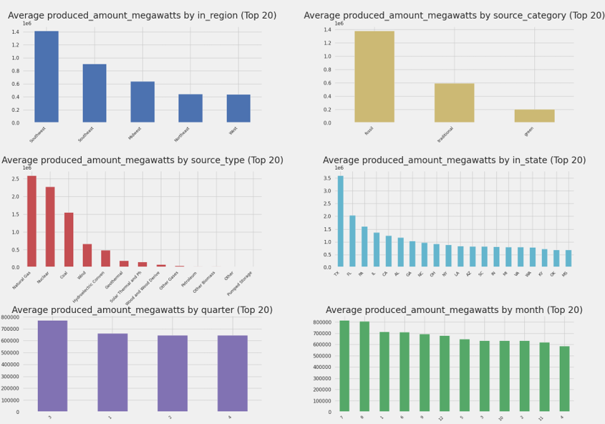
Analysis and Charts samples
Notes:
FuelSource ( coal petro, Gas)

Slide 21
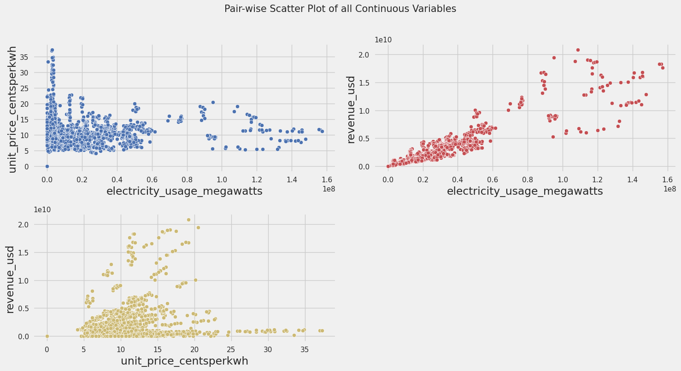
Analysis and Charts samples
Electricity Usage:
Electricity usage and Unit price are mainly located in the [0 - 0.6] and [5, 18], respectively. The higher the unit price the lower the electricity usage. When the unit price is mainly located between the 10 and 15 range, electricity usage can achieve the greatest usage.
Electricity usage and Revenue are mainly located in the [0 - 0.6] and [0 - 1], respectively. It indicates that higher electricity does not necessarily bring more revenue to this industry this industry.
Unit price and revenue are mainly located between [5 - 15] and [0 – 0.5]. It indicates that a higher unit price does not necessarily bring more revenue to this industry.
Notes:
FuelSource ( coal petro, Gas)

Slide 22
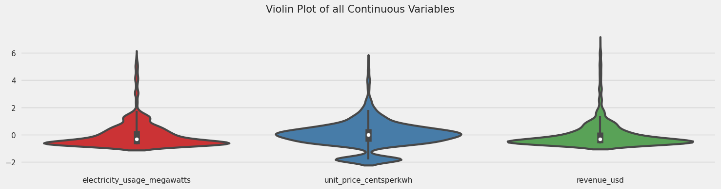
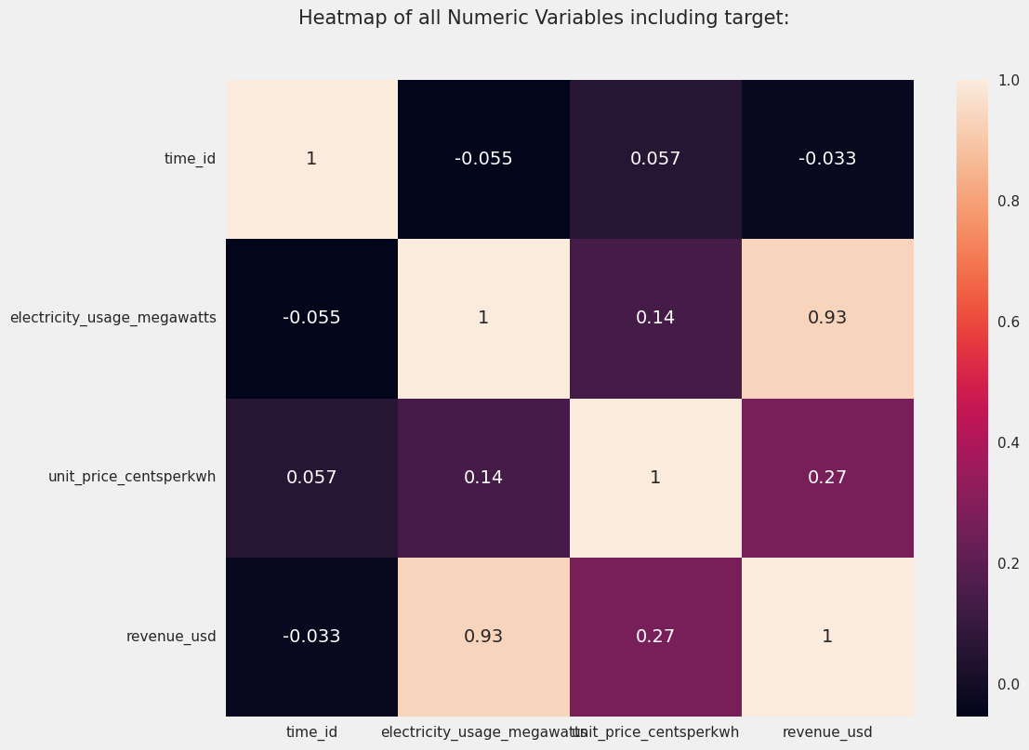
Analysis and Charts samples
Violin Plot and Heatmap of Electricity Usage in the US:
Notes:
FuelSource ( coal petro, Gas)

Slide 23
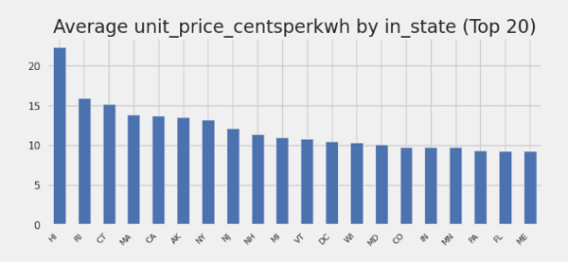
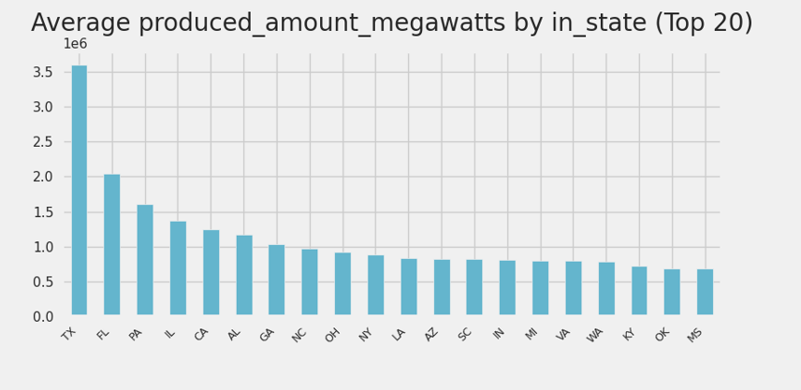
Comparison between Production and Usage:
Hawaii state has the highest unit price. Since the amount of electricity production in Hawaii is almost equal to zero. Due to the geometric location and shipping cost, the unit price of Hawaii is the highest in the US. Therefore, we can learn that the living expense is very high for people living in Hawaii.

Slide 24
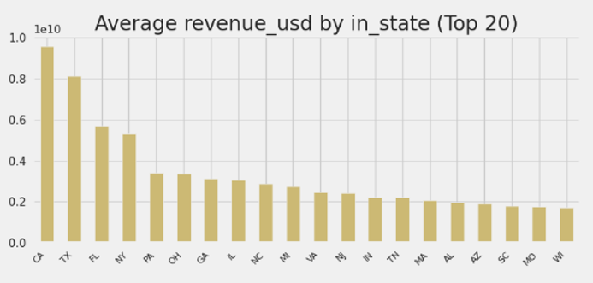
Comparison between Production and Usage:
The U.S. government should consider increasing the investment in electricity facilities in California since California created the greatest amount of electricity Revenue in the US, while its electricity production is the highest.

Slide 25
Data Visualization :
Now you can visit these links: https://elepro.yuanpengwang.me/
And https://eleusa.yuanpengwang.me/ to check my data visualization.

